Slide 1
Open Everything
Source,
Knowledge,
Access,
and Government
And what that means to you

Slide 2
Open source
In production and development, open source as a development model promotes a universal access via a free license to a product's design or blueprint, and universal redistribution of that design or blueprint, including subsequent improvements to it by anyone.
http://en.wikipedia.org/wiki/Open_source

Slide 3
Openness
Aspects
Enablers
Infrastructures
Practices
Products
Domains

Slide 4
Aspects of Openness
inclusionality or open access
permission-less contributions
full transparency of that process
full share-ability and ‘changeability’ of the common material.
All these represent new social expectations, and are key ingredients of commons-based peer production as well.
http://blog.p2pfoundation.net/open-everything-mindmap-and-visualization/2009/09/08

Slide 5
Enablers of Openness
Open Definitions :minimal conditions for openness
Source code
Licenses
Standards
Access
Data
Governance / Open Source Organization
Facilitation : Open Space
http://blog.p2pfoundation.net/open-everything-mindmap-and-visualization/2009/09/08

Slide 6
Infrastructure of Openness
open platforms, both virtual and physical, which allow us to produce in a open way:
open collaborative technical platforms,
open places where we can gather
open media and communication infrastructures we can use
open and free software knowledge and scientific data
ability to live in open and free villages and urban spaces, which connect local production with global open design communities.
http://blog.p2pfoundation.net/open-everything-mindmap-and-visualization/2009/09/08

Slide 7
Practices of Openness
Open Knowledge and Science
Open and Free Software
Open Designs
Open Hardware
Open Currencies
Open Capital

Slide 8
Products of Openness
3d printed items
Open textbooks
Open government data
Open source software
Open course ware
Open library collection data

Slide 9
Domains of Openness
Open Hardware
Open Government
Open street map
Wikipedia
Open Libraries

Slide 10
Social peer-to-peer processes
peer production - the collaborative production of use value is open to participation and use to the widest possible number (as defined by Yochai Benkler, in his essay Coase's Penguin);[1]
peer governance - production or project is governed by the community of producers themselves, not by market allocation or corporate hierarchy;
peer property - the use-value of property is freely accessible on a universal basis; peer services and products are distributed through new modes of property, which are not exclusive, though recognize individual authorship (i.e. the GNU General Public License or the Creative Commons licenses).
http://en.wikipedia.org/wiki/Social_peer-to-peer_processes

Slide 11
Open-source software
Open-source software (OSS) is computer software with its source code made available with a license in which the copyright holder provides the rights to study, change, and distribute the software to anyone and for any purpose.[1] Open-source software may be developed in a collaborative public manner. Open-source software is the most prominent example of open-source development and often compared to (technically defined) user-generated content or (legally defined) open-content movements.[2]
http://en.wikipedia.org/wiki/Open-source_software

Slide 12
Open knowledge
Open knowledge is knowledge that one is free to use, reuse, and redistribute without legal, social or technological restriction.[1] Open knowledge is a set of principles and methodologies related to the production and distribution of knowledge works in an open manner. Knowledge is interpreted broadly to include data, content and general information.
http://en.wikipedia.org/wiki/Open_knowledge

Slide 13
Open Data
Open data is the idea that certain data should be freely available to everyone to use and republish as they wish, without restrictions from copyright, patents or other mechanisms of control.[1] The goals of the open data movement are similar to those of other "Open" movements such as open source, open hardware, open content, and open access.
http://en.wikipedia.org/wiki/Open_data

Slide 14
Open Access
Open access (OA) means unrestricted online access to peer-reviewed scholarly research. Open access is primarily intended for scholarly journals, but is also provided for a growing number of theses,[2] book chapters,[3] and monographs.[4]
Open access comes in two degrees: gratis open access, which is free online access, and libre open access, which is free online access plus some additional usage rights.[5] These additional usage rights are often granted through the use of various specific Creative Commons licenses.[6] Only libre open access is fully compliant with definitions of open access such as the Berlin Declaration on Open Access to Knowledge in the Sciences and Humanities.
http://en.wikipedia.org/wiki/Open_access

Slide 15
Open access teached its tipping point in 2011
the year 2011 is a milestone for open access. By this analysis, 50% of all scientific articles published in 2011 are currently available in some open access form or another, and the trend is toward more and more articles becoming open access.
http://opensource.com/life/13/10/tipping-point-open-access-science

Slide 16
Open Source Hardware
Open-source hardware (OSH) consists of physical artifacts of technology designed and offered by the open design movement. Both free and open-source software (FOSS) as well as open-source hardware is created by this open-source culture movement and applies a like concept to a variety of components. It is sometimes, thus, referred to as FOSH (free and open source hardware). The term usually means that information about the hardware is easily discerned so that others can make it - coupling it closely to the maker movement.[1] Hardware design (i.e. mechanical drawings, schematics, bills of material, PCB layout data, HDL source code and integrated circuit layout data), in addition to the software that drives the hardware, are all released under free/libre terms. The original sharer gains feedback and potentially improvements on the design from the FOSH community. There is now significant evidence that such sharing creates enormous economic value.[2]
http://en.wikipedia.org/wiki/Open-source_hardware

Slide 17
Open Source Ecology
Open Source Ecology (OSE) is a network of farmers, engineers, architects and supporters, whose main goal is the eventual manufacturing of the Global Village Construction Set (GVCS). As described by Open Source Ecology "the GVCS is an open technological platform that allows for the easy fabrication of the 50 different Industrial Machines that it takes to build a small civilization with modern comforts."[3] Groups in Oberlin, Ohio, Pennsylvania, New York and California are developing blueprints, and building prototypes in order to pass them on to Missouri.[4][5][6] The devices are built and tested on the Factor e Farm in rural Missouri.
http://en.wikipedia.org/wiki/Open_Source_Ecology

Slide 18
OpenContent
Retain - the right to make, own, and control copies of the content (e.g., download, duplicate, store, and manage)
Reuse - the right to use the content in a wide range of ways (e.g., in a class, in a study group, on a website, in a video)
Revise - the right to adapt, adjust, modify, or alter the content itself (e.g., translate the content into another language)
Remix - the right to combine the original or revised content with other open content to create something new (e.g., incorporate the content into a mashup)
Redistribute - the right to share copies of the original content, your revisions, or your remixes with others (e.g., give a copy of the content to a friend)[3]
http://en.wikipedia.org/wiki/Open_content

Slide 19
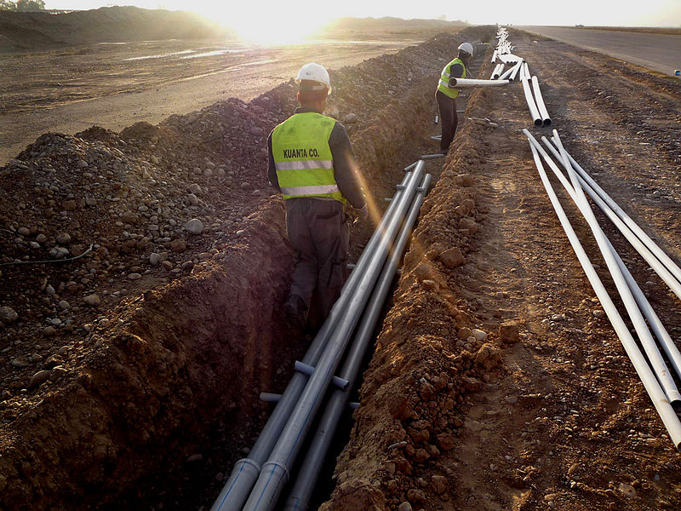
Open Infrastructure
By USAF photo (US Air Force Public Affairs [1]) [Public domain], via Wikimedia Commons
https://upload.wikimedia.org/wikipedia/commons/a/ac/Kirkuk_Infrastructure_Rebuild.jpg

Slide 20
Archive.org
The Internet Archive is a San Francisco-based non-profit digital library with the stated mission of "universal access to all knowledge".[2][3] It provides free public access to collections of digitized materials, including websites, software applications/games, music, movies/videos, moving images, and nearly three million public-domain books. As of October 2012, its collection topped 10 petabytes.[4][5] In addition to its archiving function, the Archive is an activist organization, advocating for a free and open Internet.
http://en.wikipedia.org/wiki/Internet_Archive

Slide 21
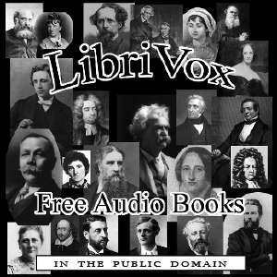
Librivox
https://librivox.org/
free public domain audiobooks

Slide 22
Wikimedia
The Wikimedia Foundation (WMF) is an American non-profit and charitable organization headquartered in San Francisco, California, that operates many wikis. The foundation is mostly known for hosting Wikipedia, an Internet encyclopedia which ranks in the top-ten most-visited websites worldwide;[5] as well as Wiktionary, Wikiquote, Wikibooks, Wikisource, Wikimedia Commons, Wikispecies, Wikinews, Wikiversity, Wikidata, Wikivoyage, Wikimedia Incubator, and Meta-Wiki. It also owned the now-defunct Nupedia.
http://en.wikipedia.org/wiki/Wikimedia_Foundation

Slide 23
Project Gutenberg
http://www.gutenberg.org/
Project Gutenberg offers over 46,000 free ebooks: choose among free epub books, free kindle books, download them or read them online.

Slide 24
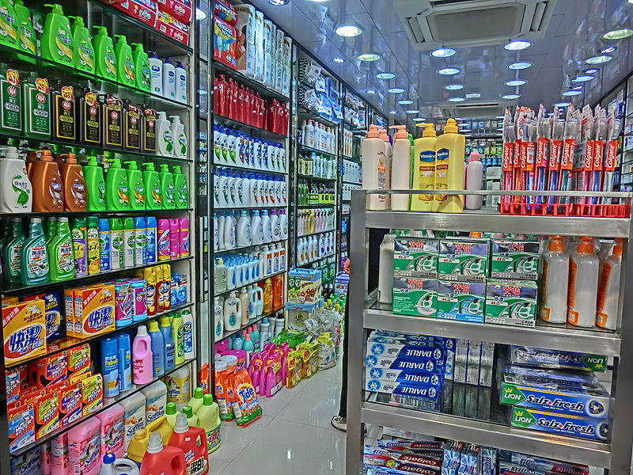
Products

Slide 25
One laptop per child
Mission Statement: To create educational opportunities for the world's poorest children by providing each child with a rugged, low-cost, low-power, connected laptop with content and software designed for collaborative, joyful, self-empowered learning. When children have access to this type of tool they get engaged in their own education. They learn, share, create, and collaborate. They become connected to each other, to the world and to a brighter future.
http://laptop.org/en/

Slide 26
Wikipedia
Wikipedia is a free-access, free content Internet encyclopedia, supported and hosted by the non-profit Wikimedia Foundation. Those who can access the site and follow its rules can edit most of its articles.[6] Wikipedia is ranked among the ten most popular websites[5] and constitutes the Internet's largest and most popular general reference work.[7][8][9]
http://en.wikipedia.org/wiki/Wikipedia

Slide 27
eGranary Digital Library
The eGranary Digital Library contains an off-line collection of approximately 30 million educational resources from more than 2,500 Web sites and hundreds of CD-ROMs and fits on a 4TB hard drive.[1] The collection includes more than 60,000 books in their entirety, hundreds of full-text journals, and dozens of software applications.

Slide 28
OCW
OpenCourseWare (OCW) are course lessons created at universities and published for free via the Internet. OCW projects first appeared in the late 1990s, and after gaining traction in Europe and then the United States have become a worldwide means of delivering educational content.

Slide 29
Offline Wikipedia
reach - it helps to reach audiences who either can't or don't want to use the Internet;
convenience - it's simply nice to have for those times when you aren't online, as rare as they increasingly are for people in developed countries.
http://strategy.wikimedia.org/wiki/Offline/Offline_Wikimedia_projects

Slide 30
Freedom Toaster
http://en.wikipedia.org/wiki/Freedom_Toaster
A Freedom Toaster is a public kiosk that will burn copies of free software onto user-provided CDs and DVDs.

Slide 31
Domain Music / Sheet music
http://www.gutenberg.org/wiki/Gutenberg:The_Sheet_Music_Project
http://imslp.org/

Slide 32
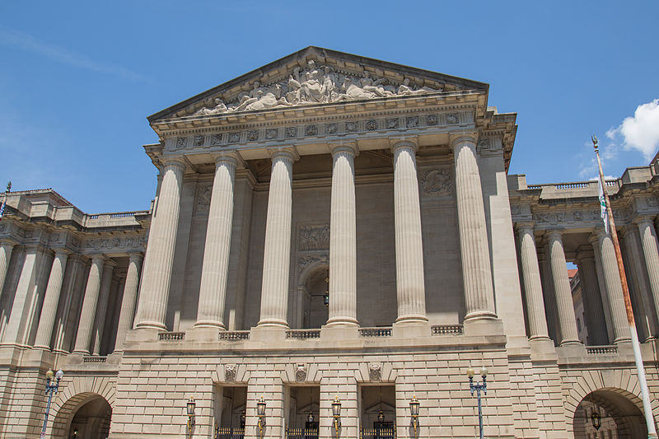
Domain : Government
https://upload.wikimedia.org/wikipedia/commons/1/1a/Andrew_W._Mellon_Auditorium_Washington_DC_6D2B4303.jpg
By Tony Webster (Own work) [CC BY-SA 4.0 (http://creativecommons.org/licenses/by-sa/4.0)], via Wikimedia Commons

Slide 33
Open Government Data
http://opengovernmentdata.org/
Data produced or commissioned by government or government controlled entities Data which is open as defined in the Open Definition – that is, it can be freely used, reused and redistributed by anyone.

Slide 34
Open Data Policy
http://sunlightfoundation.com/opendataguidelines/
http://www.datainnovation.org/2014/08/state-open-data-policies-and-portals/
https://www.whitehouse.gov/open/about/policy

Slide 35
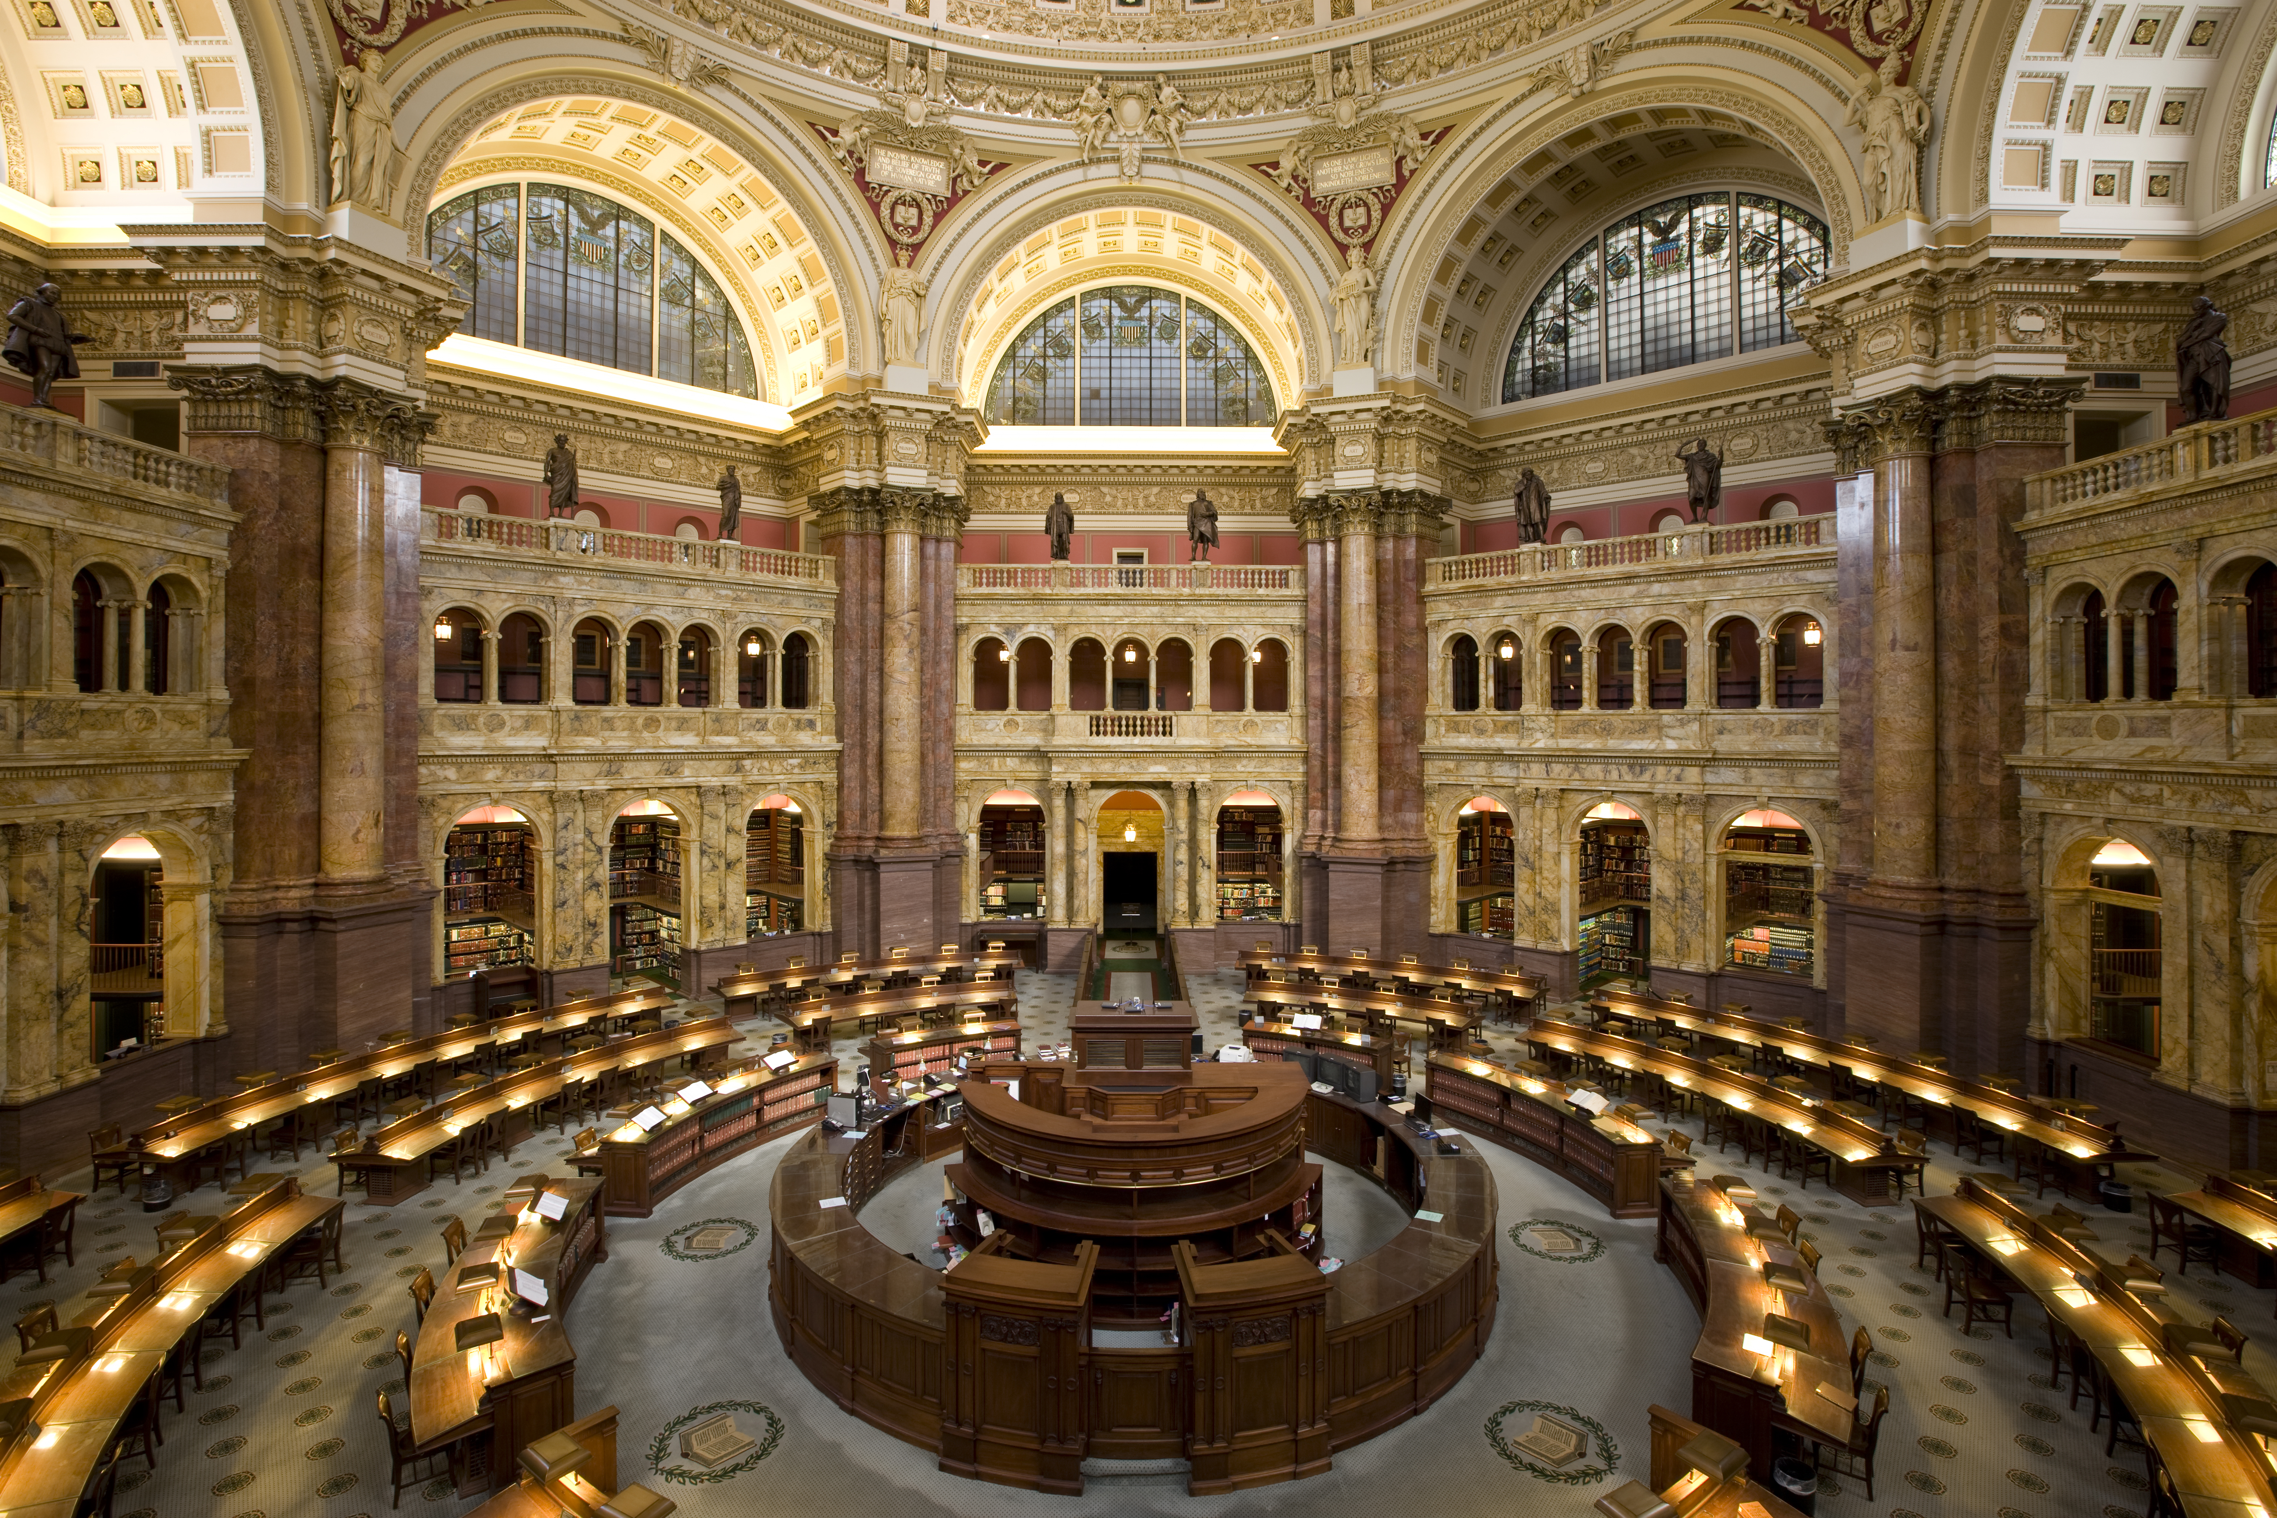
Domain : Library
Carol M. Highsmith [Public domain or Public domain], via Wikimedia Commons

Slide 36
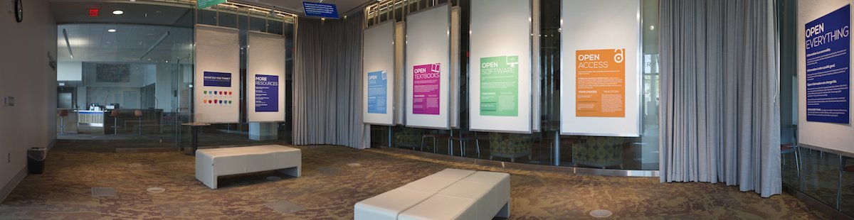
Open Everything Exhibit
http://labs.library.gvsu.edu/open/
Grand Valley State University Libraries.

Slide 37
Libraries are making scholarship accessible to all
http://americanlibrariesmagazine.org/2013/12/23/open-access-everything/
Libraries have spearheaded many projects designed to improve or transform publishing. Individually, they are simply intriguing; when viewed together they indicate a growing movement to help make publishing sustainable and research accessible.

Slide 38
Open Everything in Libraries
https://cynng.wordpress.com/2015/02/25/open-everything-in-libraries/
Open Collection Data
Open (Wifi) Access
Open Collections
Open Spaces

Slide 39
Plos
PLOS (Public Library of Science) is a nonprofit publisher and advocacy organization founded to accelerate progress in science and medicine by leading a transformation in research communication.
https://www.plos.org

Slide 40
The Public Knowledge Project
The Public Knowledge Project: Open Source Tools for Open Access to Scholarly Communication
the Public Knowledge Project, a collective of academics, librarians, and technical genies, has been, since 1998, building open source software (free) publishing platforms that create an alternative path to commercial and subscription-based routes to scholarly communication. It sets out how its various website platforms, including Open Journal Systems, Open Conference Systems, and, recently, Open Monograph Press, provide a guided path through the editorial workflow of submission, review, editing, publishing and indexing
http://book.openingscience.org/tools/the_public_knowledge_project.html

Slide 41
Ubunutu In Libraries
https://wiki.ubuntu.com/UbuntuInLibraries
Produce a simple guide to approach local libraries to accept donations of professionally / home-produced CD-ROM images of Ubuntu's various distributions (initially, i386, PPC and AMD64)

Slide 42
http://en.wikipedia.org/wiki/Wikipedia:GLAM
The GLAM-Wiki initiative ("galleries, libraries, archives, and museums" with Wikipedia; also including botanic and zoological gardens) helps cultural institutions share their resources with the world through collaborative projects with experienced Wikipedia editors.

Slide 43
Join the FSF in calling on libraries to eliminate DRM
http://www.fsf.org/news/DRMLibraryAction.html
”There is another, deeper issue at stake here. The tendency of digitalization is to convert public libraries into retail stores for vendors of digital works. The choice to distribute information in a secret format--information designed to evaporate and become unreadable--is the antithesis of the spirit of the public library.”
http://www.defectivebydesign.org/LetterToLibraries

